Slide 1
Advanced Concepts & Best Practices

Slide 2
The problem with nested data from APIs The Solution: Normalization createEntityAdapter
State Normalization

Slide 3
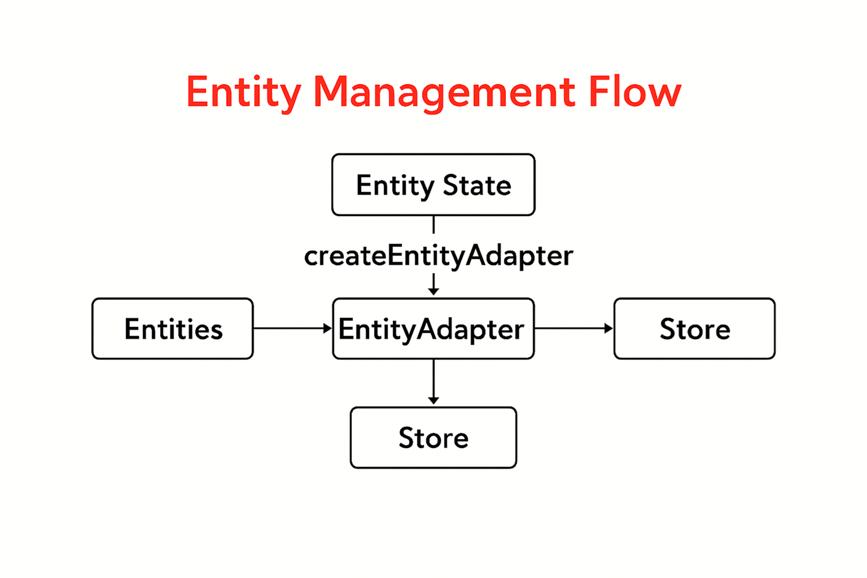
Adapter → Slice reducers (mutating-friendly with Immer) → Store, with selectors for fast reads.

Slide 4
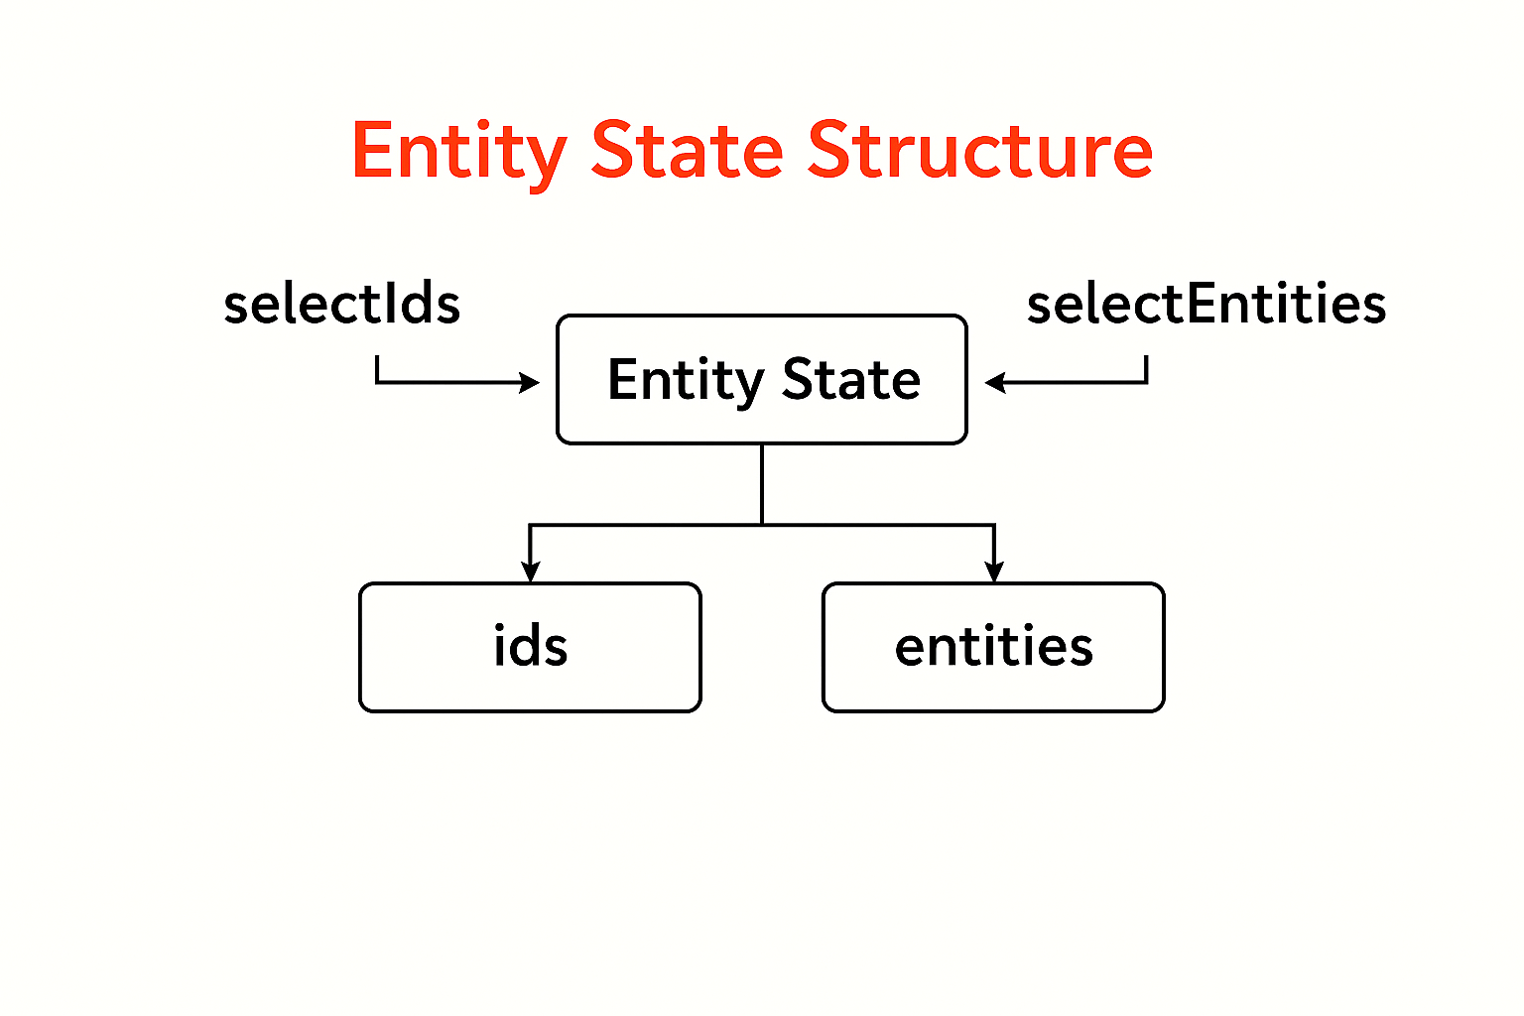
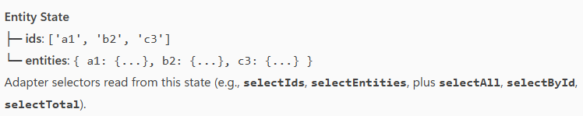
normalized state + selectors

Slide 5
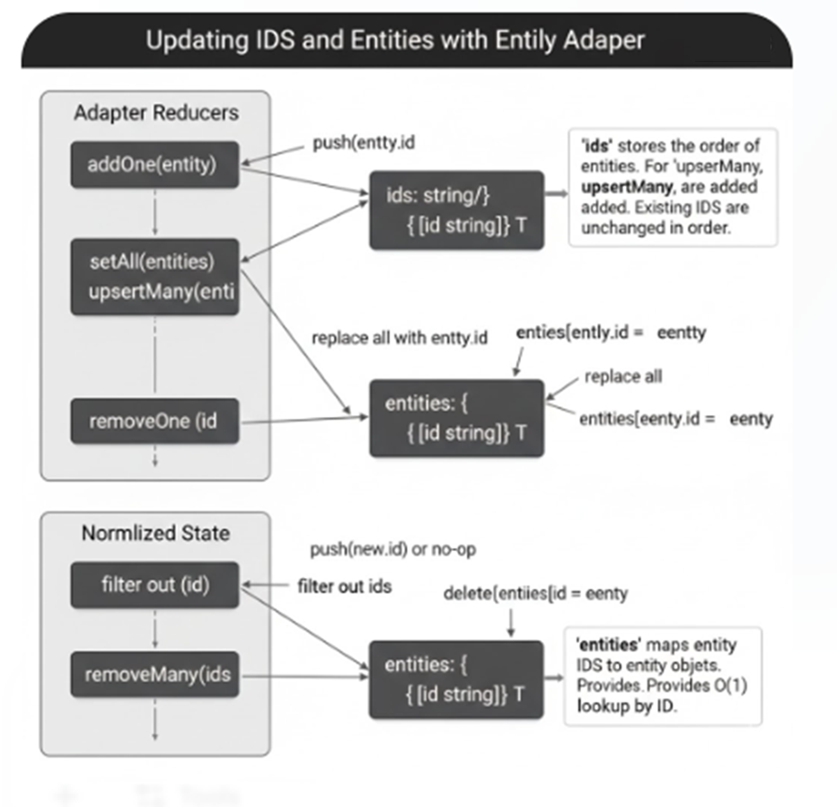

Slide 6
Normalize an API response for a list of products and manage updates to a single product item.
Hands-on Lab 4.1

Slide 7
Code Structure & Organization
folder by type
feature-based (often called the Ducks Pattern)
The recommended approach for modern, large-scale applications is the feature-based folder structure.

Slide 8
Folder-by-Type
Structure: All files of the same type are grouped together.
/actions
/reducers
/store
/components

Slide 9
Feature-Based Folder Structure (Ducks Pattern)
Structure: All files related to a specific feature are grouped together in their own directory.
/features
/user
userSlice.ts
UserProfile.tsx
/products
productsSlice.ts
ProductList.tsx

Slide 10
Middleware and Store Configuration
Built-in Middleware
redux-thunk:
Redux DevTools Extension Middleware
serializableCheck & immutableCheck

Slide 11
Action History Time-Travel Debugging State Inspection Performance Monitoring
Redux DevTools Extension

Slide 12
Next up:
Integration & Wrap-up

